Slide 1
Model Checking with SPIN
Modeling and Verification with SPIN
Wishnu Prasetya
wishnu@cs.uu.nl
www.cs.uu.nl/docs/vakken/pv

Slide 2
Overview
Architecture & a bit more about SPIN
SPIN’s modeling language
Examples of models in SPIN
Acknowledgement: some slides are taken and adapted from Theo Ruys’s SPIN Tutorials.

Slide 3
Spin and Promela
SPIN = Simple Promela Interpreter
Promela = Process Meta Language
  Is a modelling language! (not a language to build an application)
Strong features :
  Powerful constructs to synchronize concurrent processes
  Cutting edge model checking technology
  Simulation to support analysis (of the models)

Slide 4
SPIN
Concurrency is a hot area again, now that we all use multi-core CPUs.
Other applications:
  AnWeb: a system for automatic support to web application verification, Di Sciascio et al, in 14th conf. on Soft. Eng. and knowledge eng., 2002.
  Privacy and Contextual Integrity: Framework and Applications, Barth et al, in IEEE Symposium on Security and Privacy, 2006.
Notes:
Bart et al: the work formalizes some aspects of contextual integrity in a logical framework for expressing and reasoning about norms of transmission of personal information.
It begins with a simple model of the transmission of personal information, containing communications such as “Alice gives Bob a certain type of information about Charlie,” and use first-order temporal logic for expressing and reasoning about norms of transmission. For example, if Alice tells Bob her age under the principle of confidentiality, then, in the future, Bob must not disclose Alice’s age.

Slide 5
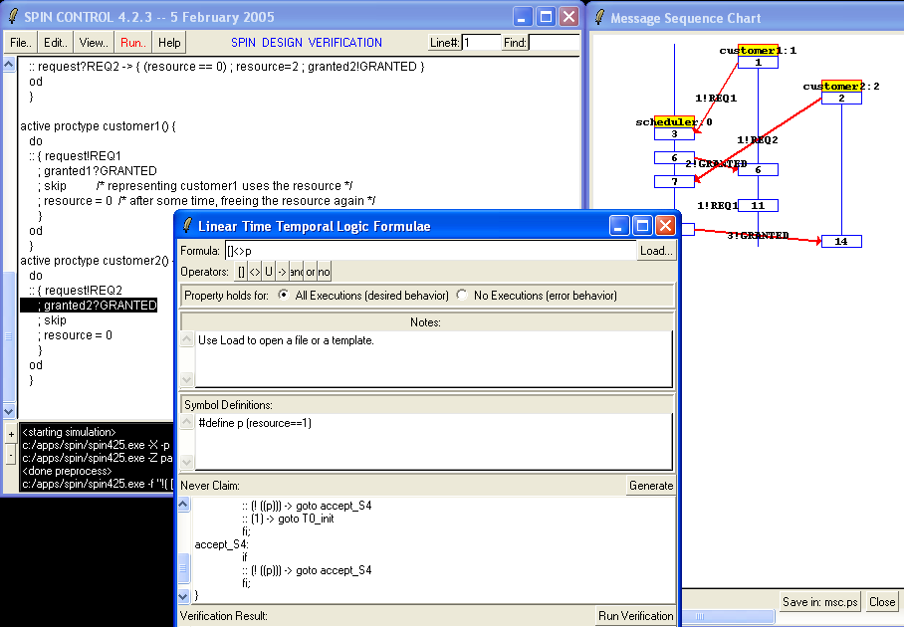
Frontend XSpin

Slide 6
(X)SPIN Architecture
•deadlocks
•safety properties
•liveness properties
spin
random
guided
interactive
ϕ
LTL
Translater
Simulator
Promela
model M
Xspin
Spin.exe
Verifier
Generator
editing window
simulation options
verification options
MSC simulation window
C program
pan.*
counter
example
false
checker
pan.exe

Slide 7
System, process, and action.
A system in SPIN consists of a set of interacting and concurrent processes.
Each process is sequential, but possibly non-deterministic.
Each process is built from atomic actions (transition).
Concurrent execution is modeled by interleaving.
Fairness can be impossed.

Slide 8
Example
byte x = 1 ;
active proctype P1() { x++ ; assert (x==2) ; }
active proctype P2() { (x==1) ; x-- ; }
(using a global variable to synchronize)

Slide 9
Data types
Bit 0,1
Bool true, false
Byte 0..255
Short -2¹⁵ .. 2¹⁵-1
Int -2³¹ .. 2³¹-1
Pid 0..255
Mtype 0..255 // user-def. enumeration
Chan 0..255
One dimensional array
Record

Slide 10
What you don’t have…
No sophisticated data types
No methods ; you have macro
There are only 2 levels of scope:
  global var (visible in the entire sys)
  local var (visible only to the process that contains the declaration)
  there is no inner blocks

Slide 11

(Enabledness) Expression
active proctype P { x++ ; (y==0) ; x-- }
This process has 3 atomic actions.
The action “y==0”
    only enabled in a state where the expression is true
    it can only be executed when it is enabled; the effect is skip
    so, as long as it is disabled, the process will block
    if it is not enabled in the current state, a transition in another process may make it enabled in the next state.
    even if it is enabled in the current state, there is no guarantee the action will be selected for execution; but there is a way in SPIN to impose fairness.

Slide 12

Example
Use it to synchronize between processes :
// both will terminate, but forcing Q to finish last
byte x=0 , y=0
active proctype P { x++ ; (y>0) ; x-- }
active proctype Q { (x>0) ; y++ ; (x==0) ; y-- }

Slide 13

Multiprogramming is tricky….
E.g. one or more processes can become stuck (deadlocked) :
(6 potential executions…)
byte x=0 , y=0
active proctype P { x++ ; (y>0) ; x-- ; (y==0) }
active proctype Q { y++ ; (x>0) ; (x==0) ; y-- }
Notes:
Dead lock scenario: y++ ; x++; (y>0) ; x-- → locked now.

Slide 14
Processes can also synchronize with channels
chan c = [3] of {byte} ;
active proctype producer() {
do
:: c ! 0
od
}
active proctype consumer() {
do
:: c ? x
od
}

Slide 15


Channels
mtype = { DATA, ack }
chan c = [0] of {bit};
chan d = [2] of {mtype, bit, byte};
chan e[2] = [1] of {bit};
for exchanging messages between processes
finite sized and asynchronously, unless you set it to size 0 → synchronous channel
Syntax :
c ! 0 sending over channel c; blocking if c is full
c ? x receives from c, transfer it to x; blocking if c is empty
d ? DATA, b, y match and receives
There are some more exotic channel operations : checking empty/full, testing head-value, copying instead of receiving, sorted send, random receive ... → check out the Manual

Slide 16


Conditional
if
:: stmt₁
:: …
:: stmt_{n}
fi
if
:: stmt₁
:: …
:: else -> …
fi
The alternatives do not have to be atomic!
The first action in an alternative acts as its “guard”, which determines if the alternative is enabled on a given state.
Non-deterministically choose one enabled alternatives.
If there is none, the entire IF blocks.
“else” is a special expression that is enabled if all other alternatives block.

Slide 17

loop : do-statement
do
:: stmt₁
:: …
:: stmt_{n}
od
Non-deterministic, as in IF
If no alternative is enabled, the entire loop blocks.
Loop on forever, as long as there are enabled alternatives when the block cycle back.
To exit you have explicitly do a break.

Slide 18



Break, syntax, etc
do
:: { (i>0) ; i-- }
:: { (i==0) ; break }
do
do
:: (i>0) → i--
:: (i==0) → break
do
do
:: { i-- ; (i>0) }
:: break
do

Slide 19
A process is allowed to be non-deterministic; can be handy for modeling.
active proctype consumer() {
do
:: c ? x;
:: c ? x; x= corrupted ; // to model occasional corrupted data
od
}

Slide 20

Label and jump
L0: (x==0) ;
if
:: … goto L0 ;
:: …
fi
Labels can also be useful in specification, e.g.
<> P@L0
Referring to labels as above goes actually via a mechanism called “remote reference”, which can also be used to inspect the value of local variables for the purpose of specification.

Slide 21
Exception/Escape
S unless E
Statement! Not to be confused with LTL “unless”.
If E ever becomes enabled during the execution of S, then S is aborted and the execution continues with E.
More precisely… check manual.

Slide 22
Predefined variables in Promela
_pid (local var) current process’ instantiation number
_nr_pr the number of active processes
np_ true when the model is not in a “progress state”
_last the pid of process that executed last
else true if no statement in the current process is executable
timeout true if no statement in the system is executable
…

Slide 23

Timeout
do
:: c ? x → ...
:: timeout → break
od
timeout becomes executable if there is no other process the system is executable/enabled
  so, it models a global timeout
  useful as a mechanism to avoid deadlock
  beware of statements that are always executable.

Slide 24

Expressing local correctness with assertions
active proctype P …
active proctype Q { …; assert (x==0 && y==0) }
(here it implies that when Q terminates, x and y should be 0)

Slide 25

But we can also express global invariant!
Thanks to built-in non-determinism in the interleaving semantics, we can also use assertion to specify a global invariant !
// implying that at any time during the run x is either 0 or 1
byte x=0 , y=0
active proctype P { x++ ; (y>0) ; x-- }
active proctype Q { (x>0) ; y++ ; (x==0) ; y--}
active proctype Monitor { assert ((x==0 || x==1)) }

Slide 26
Deadlock checking, free.
When a system comes to a state where it has no enabled transition, but one of its processes is not in its terminal (end) state:
  Deadlocked, will be reported by SPIN
  But sometimes you want to model that this is ok → suppress it via the invalid-endstate option.
The terminal state of a process P is by default just P’s textual end of code.
You can specify additional terminal states by using end-label:
  Of the form “end_1” , “end_blabla” etc

Slide 27
Expressing progress requirement
We can mark some states as progress states
  Using “progress*” labels
Any infinite execution must pass through each progress state infinitely many often by any infinite execution; else violation.
We can ask SPIN (with an option) to verify no such violation exists ( non-progress cycles option).

Slide 28
Example
Self-stabilizing leader election in a ring.
Problem-1: Leader Election (LE).
for time to time a ring of processes need to appoint a ‘leader’. A centralized decision is undesired.
Problem-2: Self-Stabilizing (SS).
It can start from any state.
A solution: (see left) → relies on the non-determinism of concurrency.
copy
5
0
copy
copy
2
min
10

Slide 29
The processes in Promela
#define N 4
byte x[N] ;
active proctype P0 ( ) {
do
:: x[N-1] < x[0] -> x[0] = x[N-1] ;
od
}
proctype P(byte i) {
do
:: x[i-1] != x[i] -> x[i] = x[i-1] ;
od
}
Why use bytes ?
Should we enable the default end-state checking?
How to instantiate the P(i)’s ?

Slide 30
Creating processes and init { … }
init {
byte i = 1 ;
do
:: i<N -> { run P(i) ; i++ ; }
:: i>=N -> break ;
od
}
Put this in atomic { … } ;
Be aware of what it means!
Unfortunately, this is not quite right yet. The array x is by default initialized to 0. How can we quantify over ‘all’ possible values of its elements?

Slide 31
Using non-determinism to quantify over your data
init {
// initializing the array x
byte i = 0 ; byte v ;
do
:: i>=N -> break ;
:: i<N ->
v = 0 ;
do
:: v<N -> v++ ;
:: break
od ;
x[i] = v ;
i++ ;
od ;
…. // now create the processes as in the previous slide
}

Slide 32
How to express the specification?
active proctype P0 ( ) {
do
:: x[N-1] < x[0] -> x[0] = x[N-1] ;
od
}
proctype P(byte i) {
do
:: x[i-1] != x[i] -> x[i] = x[i-1] ;
od
}
assert (x[i] == x[0])
(not really capturing what you mean…)

Slide 33
Using timeout to specify end-state
active proctype monitor() {
byte i ;
timeout ->
i = 0 ;
do
:: i>=N -> break ;
:: i<N -> assert(x[i]==x[0]) ; i++ ;
od
}
Does express: if the system ‘stabilizes’, all values in x are the same.
But we still can’t express that it will stabilize. How can we do it? → later.

Slide 34

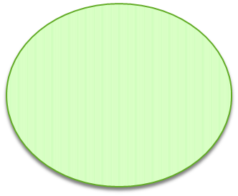
Example: Alternating bit protocol
sender
receiver
imperfect “connections”, but corrupted data can be detected (e.g. with checksum etc).
Possible solution: send data, wait for a positive acknowledgement before sending the next one.
Just 1 bit is needed for the ack, hence the “bit” in the name.

Slide 35
You can think of several ways to work it out...
A note on reliable full-duplex transmission over half-duplex links, K. A. Bartlett, R. A. Scantlebury, P. T. Wilkinson, Communications of the ACM, Vol 12, 1969.
  NPL Protocol
  M<2 Protocol (we’ll discuss this one)
For more, check out:
http://spinroot.com/spin/Man/Exercises.html
e.g. Go-Back-N Sliding Window Protocol

Slide 36




M<2 Protocol, Sender part
Fetch a new data.
1
?1
!1,data
!0,data // Sender wants to resend
2
4
? error
!1,data
? 0 // Receiver wants Sender to resend
3
State 1 is the starting state, and its accepting state in the sense when the sender is in this state, it assumes the last data package it sent has been successfully received by the receiver, and so it fetches a new data package to send.

Slide 37



M<2 Protocol, Receiver part
1
!0 // request Sender to resend
? error
!1
2
4
?0,rd
// Sender wants Receiver to resend
!1
?1,rd
3

Slide 38
Scenario: 1x error, corrected
1
Fetch a new data.
? error
!0 // request Sender to resend
1
!1
?1
!1,data
2
4
!0,data
// Sender wants to resend
?0,rd
// Sender wants
R to resend
2
? error
4
!1
?1,rd
!1,data
?0
// Receiver wants S to resend
3
3
Though each automaton is simple, the combined (and concrete) behavior is quite complex; ≈ 100 states in my (abstract) SPIN model (there are more explicit states, if we take the “data” into account).

Slide 39
Modeling in Promela
chan S2R = [BufSize] of { bit, byte } ;
chan R2S = [BufSize] of { bit } ;
proctype Sender (chan in, chan out) { … }
proctype Receiver(chan in, chan out) { … }
init {
run Sender(R2S, S2R) ;
run Receiver(S2R, R2S)
}

Slide 40
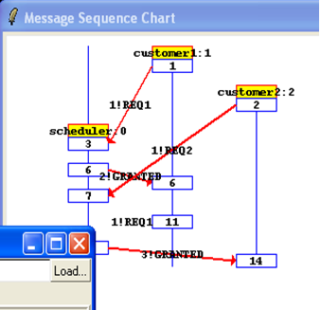
Modelling in SPIN
proctype Receiver(chan in, out) {
show byte rd ; /* received data */
show bit cbit ; /* control bit */
do
:: in ? cbit, rd ;
if
:: (cbit == 1) -> out!1
:: (cbit == 0) -> out!1
:: printf("MSC: ERROR1\n") ; out!0
fi
od
}
So, how big the channels should be? Is 0 good enough ?

Slide 41
A different style, with “goto”
proctype Sender(chan in, out) {
show byte data ; /* message data */
show bit cbit ; /* received control bit */
S1: data = (data+1) % MAX ; out!1,data ; goto S2;
S2: in ? cbit ;
if
:: (cbit == 1) -> goto S1
:: (cbit == 0) -> goto S3
:: printf("MSC: AERROR1\n") -> goto S4
fi ;
S3: out!1,data ; goto S2 ;
S4: out!0,data ; goto S2 ;
}

Slide 42

Specification, with assertions?
Each data package, if accepted by the receiver, is accepted exactly once!
This time, not possible with assertions (at least not without the help of ‘something else’).
In LTL (to be discussed later), we can try something along this line :
But this still does not quite express the above.
□(Receiver@S3 → (Receiver@rd == Sender@data))

Slide 43
Specification, using shadow variables
Each data package, if accepted by the receiver, is accepted exactly once!
Extend the model with ‘shadow variables’
  Are used purely for expressing specifications
  Must not influence the original behavior
In our case:
  exploit that sender generates new data by data+1
  introduce a shadow variable “last” → previously accepted data
  Impose this assertion on the acceptance state (of Receiver):
current data to be accepted = last + 1

Slide 44

Extending the model
proctype Receiver(chan in, out) {
show byte rd ; /* received data */
show bit cbit ; /* control bit */
do
:: in?cbit,rd ;
progress:
if
:: (cbit == 1) -> out!1
:: (cbit == 0) -> out!1
:: printf("MSC: ERROR1\n") ; out!0
fi
od
}
show byte last
assert (rd == (last+1) % MAX) ;
last = rd ;
This is the Receiver’s accepting state S3

Slide 45
2x successive errors
1
Fetch a new data.
? error
!0 // request Sender to resend
1
!1
?1
!1,data
2
4
!0,data
// Sender wants to resend
?0,rd
// Sender wants
R to resend
2
? error
4
!1
?1,rd
!1,data
?0
// Receiver wants S to resend
3
3
Ouch…

Slide 46
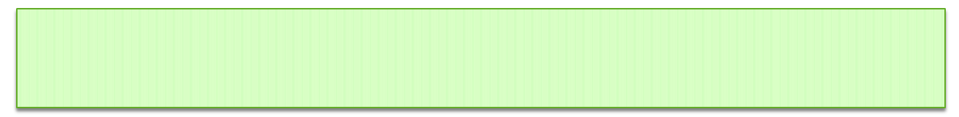
Ok... but suppose we still want to verify these:
But, if error does not occur twice successively then: every pck sent, if accepted, is accepted exactly once.
If no error occur, every data sent will eventually be accepted.
The first can be expressed simply by constraining the model, namely how it simulates error.
The 2nd one can’t be expressed with just assertions and shadow variables.
Alternative: LTL.

